Slide 1

Industrial Training Report
(Summer Internship)
Presentation
On
Housing Price Prediction
During Covid
Submitted To
Mr. Basudeo Singh Roohani
Ms. Shanu Priya Chauhan
(Internship Coordinators)
Submitted By Supervised By
Shaurya Seth Ms. Vandna Tomar
2101430100162 AP, CSE Deptt.
7th Sem, CSE-4
Department of Computer Science & Engineering
IMS Engineering College, Ghaziabad, India
(2024-25)

Slide 2
Outline & Contents
Introduction
  Company Profile
Requirement Analysis
Problem Statement & Objectives
System Requirement Specification
  H/W requirement specification
  S/W requirement specification
Technology Used/Methodology
Result
Conclusion
Reference

Slide 3
Company’s Introduction
Froyo Technologies Private Limited (FT) is a global leader in skills and talent development, offering diverse learning solutions for individuals, professionals, institutions, and government entities. Founded in 2017 and headquartered in Noida, Uttar Pradesh, FT operates in over three countries, serving clients across various industries.
FT provides comprehensive training in IT, data analytics, cybersecurity, finance, and soft skills, including industry-recognized certifications, corporate training, and e-learning platforms.
Our global presence and continuous innovation have earned us industry recognition and numerous accolades. At Froyo Tech , we are committed to customer satisfaction, delivering customized solutions that exceed expectations.

Slide 4
Requirement Analysis
Data Collection and Preprocessing:-
  Data Sources:- Various sources provide valuable data, including price range, Facilities. This data serves as the foundation for predicting the models
  Data Transformation:- Data transformation often involves scaling and encoding. This converts data into a format suitable for machine learning algorithms, improving model performance.
  Data Cleaning:- Data cleaning is essential for accurate predictions. It involves addressing missing values, inconsistent data formats, and outliers. This step ensures data quality and reliability.
2. Data Analysis:-
  Collecting and analyzing relevant data
  Features :-
City, Location, BHK, Security, School, Hospital, Parking, Wifi, ATM, Power Backup Price (Target Variable)

Slide 5
3.Modeling Approach-
Model Selection:-
    Start with baseline models (e.g., linear regression) to set a performance benchmark.
    Explore advanced models such as Decision Trees, Random Forests.
Model Evaluation:-
  Split the dataset into training, validation, and test sets.
  Use evaluation metrics like Mean Absolute Error (MAE), Mean
  Squared Error (MSE), Root Mean Squared Error (RMSE), and R-squared to assess model performance.
Deployment:-
    Choose a deployment strategy (e.g., batch processing, real-time predictions via API).
    Use platforms like AWS, Azure, or Google Cloud for deployment.

Slide 6
Problem statement & Objectives
The objective of this project was to analyze the impact of the COVID-19 pandemic in 2019 on housing prices and predict future prices by applying data science and machine learning techniques.
The Objectives are as follows:-
  Data Cleaning and Pre-processing
  Feature Engineering of Location
  Model Development
  Data Visualization
  Model Evaluation and Optimization

Slide 7
System Requirement Specification
Hardware Requirement Specification:-
Computer (Desktop or Laptop):
Processor (CPU):
  Minimum: Dual-core processor (e.g., Intel Core i3, AMD Ryzen 3).
  Recommended: Quad-core or higher (e.g., Intel Core i5/i7, AMD Ryzen 5/7)
Memory (RAM):
  Minimum: 8 GB.
  Recommended: 16 GB or more.
Display:
Minimum: Full HD (1920x1080) resolution.
Recommended: 4K (3840x2160) resolution or dual monitors .

Slide 8
Internet Connection:
    Minimum: 10 Mbps download/upload speed
    Recommended: 50 Mbps or higher with low latency
Test Devices:-
  Physical mobile devices (smartphones, tablets) can be valuable for testing responsive designs and user experience on different platforms.
Storage:-
  Minimum: 2 GB SSD
Software Requirement Analysis
Operating System:
Windows, macOS, or Linux:
  Choose an OS that are comfortable with and that supports the development tools you intend to use.
  I go through the Windows because I already worked and familiar with it.

Slide 9
Data Science Tools:-
  Jupyter Notebook:- Essential for interactive coding, data analysis, and visualization.
  Python:- Programming languages commonly used in data science for analysis and model development.
Web Browsers:-
  Chrome, Firefox, Safari, Edge:Popular browsers for testing and debugging websites. I prefer Chrome which offer powerful developer tools for inspecting and debugging HTML, CSS, and JavaScript.
Code Editor / Integrated Development Environment (IDE):-
    Jupyter Notebook:- Used for writing and executing code, visualizing data, and documenting the analysis process.Frameworks

Slide 10
Technology Used/Methodology
Data Science and Analytics:-
Python:-
  Purpose:- Purpose: A versatile programming language widely used for data analysis, statistical computations, and building machine learning models. Commonly used libraries include Pandas for data manipulation, NumPy for numerical computations, and Matplotlib/Seaborn for data visualization.
Data Handling and Storage:-
SQL Databases:-
  Purpose: Used for managing and querying relational databases. Commonly used databases include MySQL, PostgreSQL, and SQLite.
NoSQL Databases:-
    Purpose:- Used for handling unstructured or semi-structured data. Examples include MongoDB for document-oriented storage and Redis for in-memory data structure store.

Slide 11











Methodology
Data Collection
Data Cleaning
Data Analysis
Model Building
Model Evaluation
Deployment

Slide 12
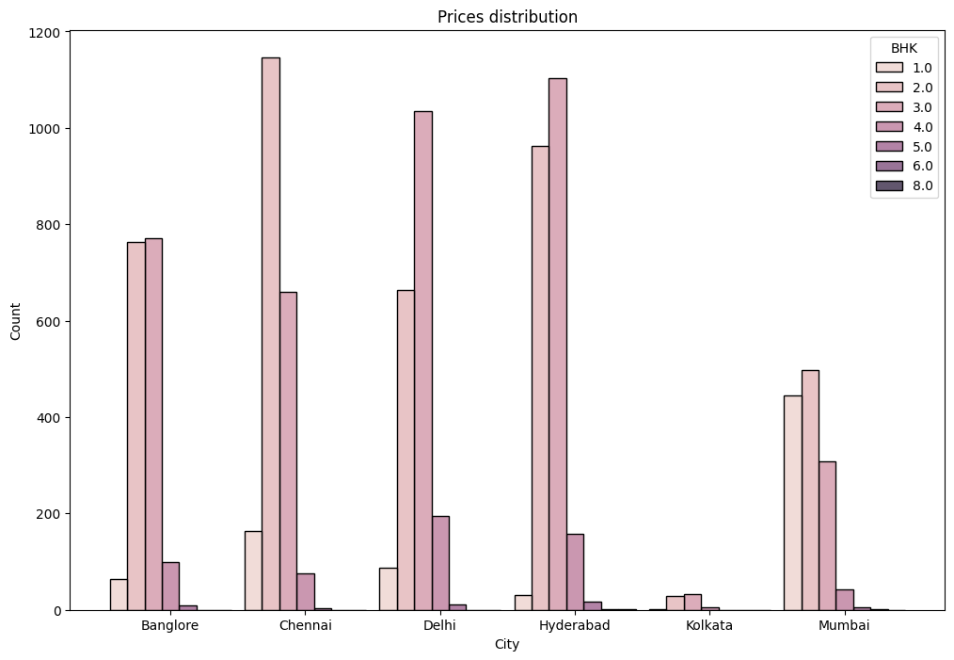
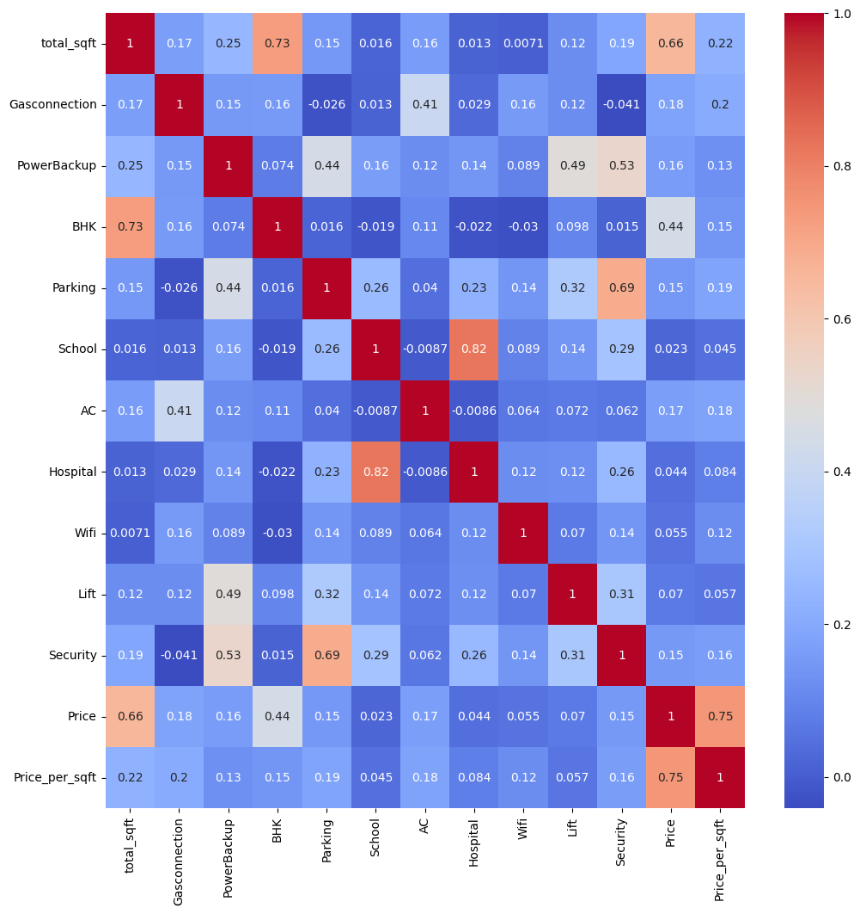
Implementation

Slide 13
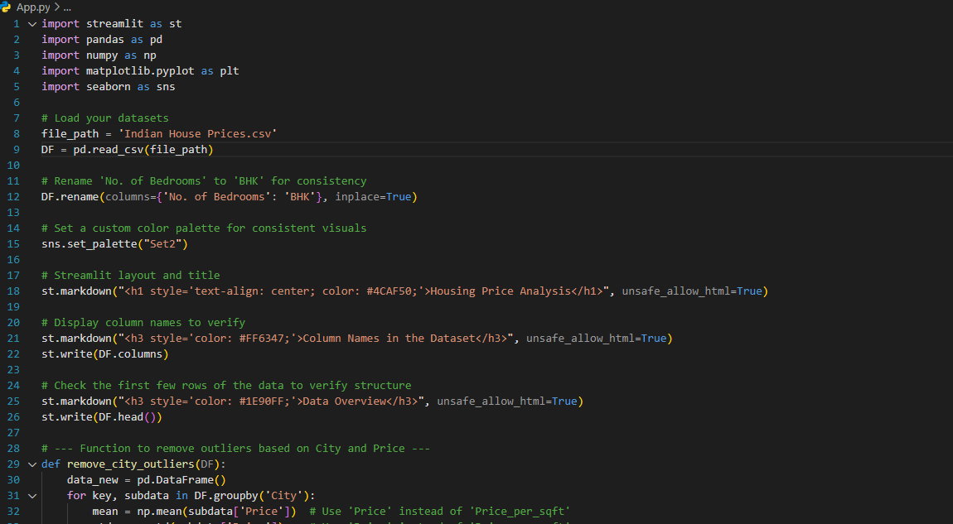

Slide 14
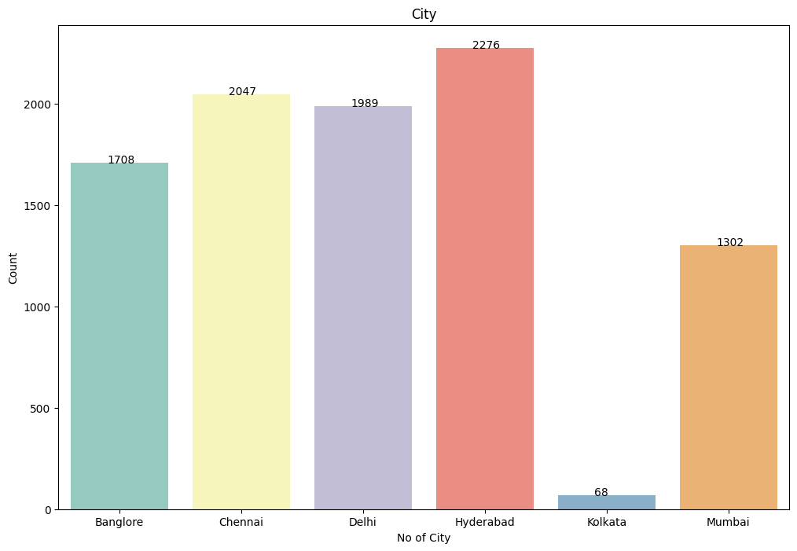
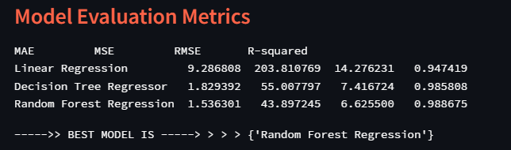
Result
This is the final result of the development of Chart and Streamlit UI

Slide 15
Conclusion
Through a structured and data-driven methodology, we successfully analyzed the effects of COVID-19 on housing prices and constructed predictive models to forecast future trends. Our notable achievements included the development of detailed location-based features and the optimization of machine learning algorithms, resulting in reliable and actionable predictions. Among the evaluated models, Random Forest Regression stood out as the most effective, achieving the lowest mean squared error (MSE) among our tests. This project fulfills its initial objectives but also establishes a solid groundwork for future enhancements as new data emerges and market dynamics continue to shift.

Slide 16
References
[1] A. Gupta et al., "House Price Prediction Using Machine Learning
Techniques," Int. Res. J. of Modernization in Engineering Technology
and Science, vol. 3, no. 5, 2024.
• [2] R. Sharma et al., "Predicting Real Estate Prices Using Random
Forest Regression," Int. J. of Adv. Research in Computer and Comm.
Engg., vol. 10, no. 2, 2024.
• [3] M. Verma et al., "Automated House Price Prediction Model Using
Data Science," E3S Web of Conferences, vol. ICMPC 2024, 01053,
2024. DOI: 10.1051/e3sconf/202443001053.
• [4] S. Patel et al., "Real-Time House Price Prediction Using Streamlit
and Machine Learning," AIP Conf. Proc., vol. 2555, 020018, 2024.
DOI: 10.1063/5.0108928

Slide 17
Thank you!!

